Slide 1
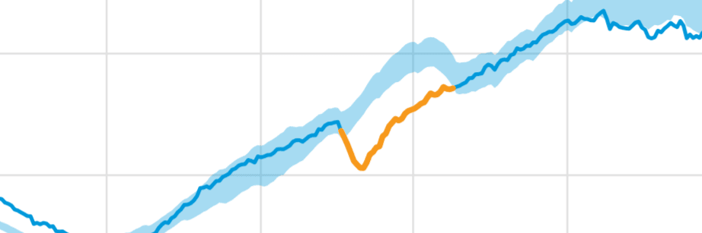
Anomaly Detection
Garry Singh

Slide 2
Overview
What is Anomaly Detection?
Types of Anomalies
Detecting Anomalies
Industries the benefit from anomaly detection
Fraud Detection
Medical and Public Health Anomaly Detection
Issues with Anomaly Detection
Importance Of Anomaly Detection

Slide 3
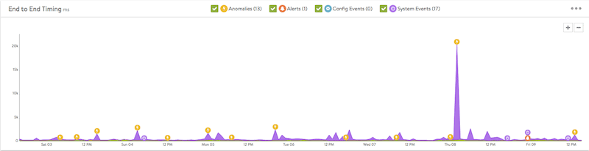
What is Anomaly Detection?
Anomaly detection refers to the problem of ﬁnding patterns in data that do not conform to expected behavior.
Identifying rare events, items, or observations which are suspicious because they differ significantly from standard behaviors or patterns
Anomalies in data occur very rarely
They are generated by a variety of abnormal activities such credit card fraud, mobile phone fraud, cyber attacks, which are significant to data analysts

Slide 4
Types of Anomalies
Point anomaly : When a particular data instance deviates from the normal pattern of the dataset.
Example: a person's' normal car fuel usage is five gallons per day but if it becomes fifty gallons in any random day, then it is a point anomaly.
Contextual anomaly: When a data instance behaves anomalously in a particular context
Example: Usage on a credit card during holiday session such as Christmas or New Year, is usually higher than during the rest of the year
Collective anomaly: A set of data instances collectively helps in detecting anomalies. If a collection of related data instances is anomalous with respect to the entire data set

Slide 5
Types of Anomalies
Network anomalies: - Monitoring of a network for unexpected trends or events
Application performance anomalies - Simply anomalies detected by end-to-end application performance monitoring.
Web application security anomalies - Suspicious web application behavior that might impact security such as CSS attacks or DDOS attacks.

Slide 6
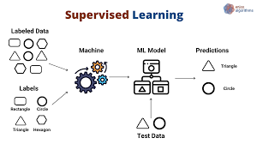
Detecting Anomalies Techniques
Detecting Anomalies depend on data labeling which is the process of identifying raw data (images, text files, videos, etc.) Anomaly detection techniques rely on Machine Learning. The methods depends on the available labels in the dataset:
Unsupervised: All the observations in the dataset are unlabeled and the algorithms learn to inherent structure from the input data.
Semi-Supervised: Some of the observations of the dataset are labeled but most of them are usually unlabeled. So, a mixture of supervised and unsupervised methods are usually used.
Supervised: All the observations in the dataset are labeled and the algorithms learn to predict the output from the input data.

Slide 7
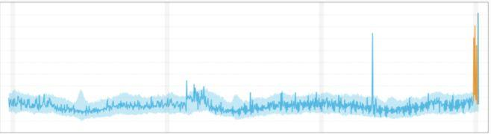
Detecting Anomalies Techniques - Time series Data
Time series data is composed of a sequence of values over time. Time series data anomaly detection must understand normal behavior in primary KPIs. Finding outliers in KPI.
Global outliers: outliers that exist far outside the entirety of a data set.

Slide 8
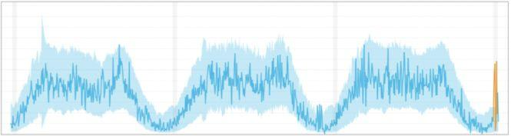
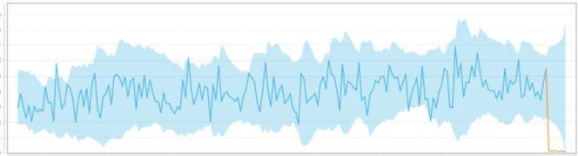
Detecting Anomalies Techniques - Time series Data
Contextual outliers - A value that significantly deviates from the rest the data points in the same context.
Collective outliers - Data points within a set is anomalous to the entire dataset

Slide 9
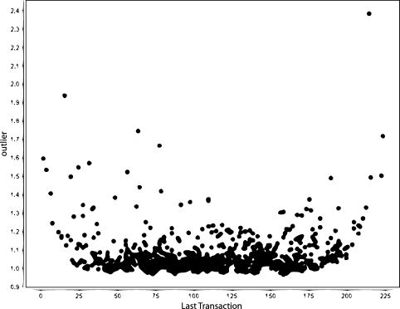
Issues with Anomaly Detection
Can be difficult task that requires heavy understanding of the data.
Rare to find
It can be intimidating or seem complex if you don’t understand the behaviors
Finding patterns in data that do not conform to expected behavior.

Slide 10
Industries the benefit from anomaly detection
Banks - Flag abnormally high transactions and fraudulent activity
Retail - Processing large volumes of financial transactions to identify fraudulent behaviors, such as identity theft and fraudulent credit card usage.
Manufacturing- Identifying machines and tools that are underperforming
IT - Being able to to detect and act on personal threats to users and financial threats to service providers
Government - Identifying excessive and fraudulent government spending, budgeting, and audits

Slide 11

Fraud Detection
Anomalies can help detect Fraud and suspicious activity.
Credit Card Fraud
Cell Phone companies
Stock Market
Insurance agencies

Slide 12
Medical and Public Health Anomaly Detection
Anomaly Detection can help in the medical field :
Abnormal Patient Condition
Recording errors
Detecting diseases
Detecting anomalies in medical images and records can help experts to diagnose and treat patients more effectively.

Slide 13
Importance Of Anomaly Detection
Helps detect network intrusion
Being able to Detect Patterns is important to prevent hacking and detecting fraud.
Can prevent security breaches
Help detect diseases
Companies need to be able to identify and react to changing operational conditions.

Slide 14
Citations
Monowar H. Bhuyan; D. K. Bhattacharyya; J. K. Kalita. “Network Anomaly Detection.” IEEE Xplore Temporarily Unavailable, https://ieeexplore.ieee.org/abstract/document/6524462.
Ahmed, Mohiuddin, et al. “A Survey of Network Anomaly Detection Techniques.” Journal of Network and Computer Applications, Academic Press, 11 Dec. 2015, https://www.sciencedirect.com/science/article/abs/pii/S108480451 5002891.
Minnesota, Varun Chandola University of, et al. “Anomaly Detection: A Survey.” ACM Computing Surveys (CSUR), 1 July 2009, https://dl.acm.org/doi/abs/10.1145/1541880.1541882.
“What Is Anomaly Detection? Definition & Faqs.” Avi Networks, 3 June 2021, https://avinetworks.com/glossary/anomaly-detection/.
Tarem Ahmed, Boris Oreshkin and Mark Coates. Machine Learning Approaches to Network Anomaly Detection. https://citeseerx.ist.psu.edu/viewdoc/download?doi=10.1.1.129.23 8&rep=rep1&type=pdf

